Slide 1

Domain: MATLAB
Technology: COMMUNICATION
CLUSTERING ROUTING ALGORITHM FOR WIRELESS SENSOR NETWORK
BASED ON MIXED STRATEGY GAME THEORY

Slide 2
Index
Abstract
Introduction
Literature review
Existing Method
Disadvantages
Proposed method
Advantages
Applications
Hardware and Software Requirements
Results
Conclusion
References

Slide 3
Abstract
We propose a clustering routing algorithm for wireless sensor networks (WSNs) based on mixed strategy game theory (CR-MSGT), which simulates the behavior of sensor nodes in a network through the mixed strategy model, so as to determine whether sensor nodes participate in the election of candidate cluster heads (CHs). The sensor nodes are randomly selected as CHs or common nodes according to their residual energy and the average energy of the network. Games are continuously played between nodes until the revenue function is maximized to reach the game equilibrium, thus proving the existence of the Nash equilibrium. Experimental results show that CR-MSGT can effectively extend the survivability of a network and mitigate the energy consumption of nodes.

Slide 4
Introduction:
A wireless sensor network (WSN) has sensor nodes, which can perceive a certain range of environmental information, as the basic unit. In recent years, with the rapid adoption of the Internet of Things, the range of applications of WSNs has become increasingly extensive and now includes smart medical care,(1) smart transportation,(2) modern agriculture,(3) and warehouse management.(4,5) For a WSN, the survival status of nodes affects the information perception ability of the entire network and determines the operating life of the network. Sensor nodes are usually driven by a limited amount of power, and their ability to calculate, store, and transmit data is also limited. Because of the large number of sensor nodes in most networks, battery replacement is generally unfeasible, so reducing node energy consumption and extending the network life are important research directions. Cluster routing is an effective technology to solve the above problems, where the core idea is to divide the network into multiple clusters with each cluster having a node called the cluster head (CH). The task of communicating with the base station (BS) is completed by the CH node. The nodes in the network take turns acting as the CH. The CH integrates the information collected by other nodes in the cluster, then forwards the information to the BS via a multi-hop or direct communication mode. The clustering mechanism can reduce the amount of forwarding data and shorten the data transmission distance of most nodes. However, the node acting as the CH consumes more energy than the other nodes in the cluster. Our task is to select the most suitable node in the network to act as the CH through game theory, which can balance the node load and energy. Game theory provides a decision-making environment model that is interdependent and may exchange roles. In this paper, a clustering routing algorithm for a WSN based on mixed strategy game theory (CR-MSGT) is proposed

Slide 5
Literature review:
S. NO | Journal Type with year | Authors | Title | Outcomes
1 | 66 (2020) 223 | P. Chanak and I. Banerjee | Distributed congestion Control algorithm For IOT-enabled WSN | Studied about the Control Algorithm in wsn
2 | (2021) 65660 | M. N. M. Bhutta and M. Ahmad | Secure Identification, Traceability and Real-Time Tracking of Agricultural Food Supply During Transportation Using Internet of Things | Studied about Secure identification using IOT
3 | 10(2019)4323 | 4 S. A. Alavi, K. Mehran, Y. Hao, A. Rahimian, H. Mirsaeedi, and V. Vahidinasab | Low-Power Wide Area Network Technologies for Internet-of-Things | Studied about Low Power wide Area network
4 | 9 (2020) 696 | Q. Li, N. Zhang, M. Cheffena, and X. Shen | Distributed Event-Triggered Control Strategy for DC Microgrids Based on Publish-Subscribe Model Over Industrial Wireless Sensor Networks | Studied about the Distributed Event in WSN.
5 | 6 (2018) 3024 | . B. Valencia, L. C. Londono, D. M. Viloria, and M. R. Garcia | Channel-Based Optimal Back-Off Delay Control in Delay-Constrained Industrial WSNs | Studied about Channel Based Optimal Back in WSN

Slide 6
Existing methods:
The first proposed clustering protocol is the LEACH (LOW ENERGY ADAPTIVE CLUSTERING HIERARCHY) protocol. The operation of LEACH protocol consists of several rounds with two phases in each: Set-up Phase and Steady Phase.
The Set-Up Phase where Cluster Heads are chosen and Cluster Formation are done. In steady state Phase the data transmission takes place between nodes to CH and CH to BS.The main idea is to choose the CH in a clustered manner at each round and then have the nodes join the closest CH to form a dynamic cluster. This network topology is built on the chosen CHs, which is inefficient due to the lack of consideration for node residual energy. Furthermore, prioritising CH selection results in the forming of complex clusters at each round, resulting in an increase in energy overhead due to cluster formation after each re-selection phase for CHs.

Slide 7
Disadvantages in Existing methods:
One of the biggest disadvantage of LEACH is that when due to any reason Cluster head dies, the cluster will become useless because the data gathered by the cluster nodes would never reach its destination i.e. Base Station.
CH selection is the most difficult part of dynamic clustering.
LEACH disregards the BS and cluster head geographical positions, energy consumption.
We have noticed that the cluster head missions are more than the ordinary nodes, so the cluster head consumes more energy than the others which one of the drawbacks of the LEACH algorithm.

Slide 8
Proposed method:
In a game model, a pure strategy refers to the case that participants can choose only one strategy, whereas in a mixed strategy, participants can choose different strategies with given probabilities. A mixed strategy is the spatial probability distribution of a pure strategy, which is a special case of a mixed strategy. In regions with a communication radius of R and N sensor nodes, the game is represented by G(N, S, U). The actions of nodes are organized in rounds, and in each round, sensor nodes can select policies from the strategy set S = {Ych, Nch}, where Ych represents participation in the candidate CH election and Nch represents nonparticipation in the candidate CH election. 1 2 1 2 ( , ) (0 1, 1) i i i ik i i p pp p p p = ≤≤ += indicates that sensor node i participates in the candidate CH election with probability pi1 and does not participate with probability pi2. The N sensor nodes participate or do not participate in the candidate CH election with probability p = (p1, p2, …, pN) as the mixed strategy of this paper. U represents the network utility, which is formulated as a revenue cost model, and different selection strategies for sensor nodes yield different gains. To maximize the network utility, the sensor node selects strategy Ych as a candidate CH or strategy Nch as a common node. In the clustering algorithm, different nodes choose to become candidate CHs or common nodes with different probabilities, resulting in different revenue functions. To maximize the network utility, a mixed strategy game is formed between all sensor nodes.

Slide 9
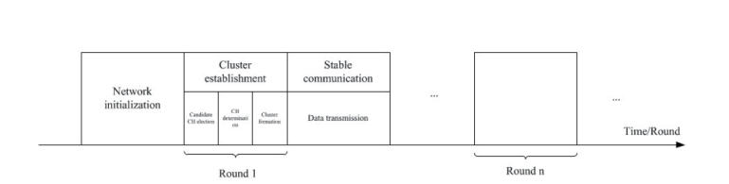
Flow of the proposed method

Slide 10
Advantages of Proposed method:
This method reduces the number of forwarding packets and extends the network life by collecting energy from the network.
Easy to implement and easy to understand

Slide 11
Applications:
industrial control
environmental monitoring,
military surveillance,
intelligent transportation systems and medical field.
Furthermore, it can function independently in harsh or high-risk places where human presence is not possible
Disaster relief operations.
Biodiversity mapping
monitoring of temperature, pressure, and humidity..

Slide 12
Hardware and Software Requirements:
Hardware & Software Requirements:
Software: Matlab R2018a.
Hardware:
Operating Systems:
• Windows 10
• Windows 7 Service Pack 1
• Windows Server 2019
• Windows Server 2016
Processors:
Minimum: Any Intel or AMD x86-64 processor
Recommended: Any Intel or AMD x86-64 processor with four logical cores and AVX2 instruction set support
Disk:
Minimum: 2.9 GB of HDD space for MATLAB only, 5-8 GB for a typical installation
Recommended: An SSD is recommended a full installation of all Math Works products may take up to 29 GB of disk space
RAM:
Minimum: 4 GB
Recommended: 8 GB

Slide 13
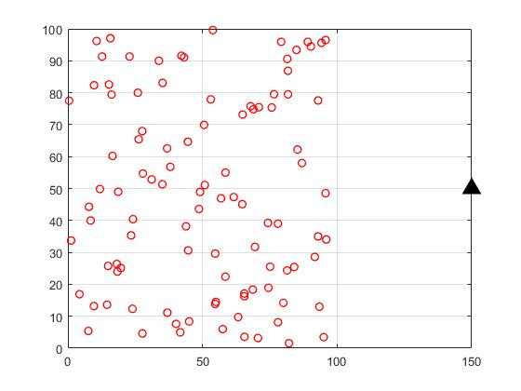
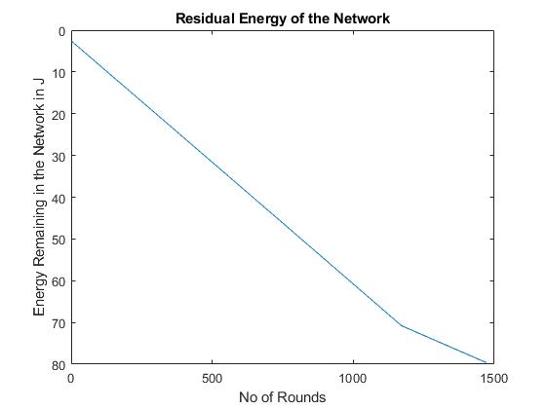
Results:

Slide 14
Results:

Slide 15
CONCLUSION:
Toward solving the clustering routing problem in WSNs, we propose an algorithm based on CR-MSGT in this paper. All sensor nodes choose whether to become the CH with a random probability, resulting in a mixed strategy game model. In accordance with the mixed strategy game model, the CH node set in the network is determined in order to form clusters and carry out stable communication. Experimental results show that the proposed algorithm can effectively balance the energy consumption of nodes, thereby prolonging the life of the network.

Slide 16
References:
1 P. Chanak and I. Banerjee: IEEE Trans. Consum. Electron. 66 (2020) 223. https://doi.org/10.1109/ TCE.2020.2987433 ]
2 M. N. M. Bhutta and M. Ahmad: IEEE Access 9 (2021) 65660. https://doi.org/10.1109/ACCESS.2021.3076373
3 J. B. Valencia, L. C. Londono, D. M. Viloria, and M. R. Garcia: IEEE Internet Things J. 6 (2018) 3024. https:// doi.org/10.1109/JIOT.2018.2878528
4 S. A. Alavi, K. Mehran, Y. Hao, A. Rahimian, H. Mirsaeedi, and V. Vahidinasab: IEEE Trans. Smart Grid 10(2019)4323. https://doi.org/10.1109/TSG.2018.2856893
5 Q. Li, N. Zhang, M. Cheffena, and X. Shen: IEEE Trans. Wireless Commun. 19 (2020) 696. https://doi. org/10.1109/TWC.2019.2948156
6 M. A. Rahman, L.-M. Ang, and K. P. Seng: IEEE/ACM Trans. Comput. Biol. Bioinf. 18 (2021) 765. https://doi. org/10.1109/TCBB.2020.2978188

